Slide 1
CEUE203
Object Oriented Programming (Java)

Slide 2
Teaching Scheme
Teaching Scheme | Theory | Practical | Total | Credit
Hours/Week | 2 | 2 | 4 | 3
Marks | 50 (9/25 + 9/25) | 50 (9/25 + 9/25) | 100
Internal Theory Evaluation(25)
  Internal Theory Examination (10)
  Three Quizzes (Best of two) (10)
  MOOC Course(05)
  Passing Marks: 9
Internal Practical Evaluation(25)
  Practical Evaluation Exam (10)
  Term Work Submission (10)
  Assignment (05)
  Passing Marks: 9

Slide 3
Teaching Scheme
Teaching Scheme | Theory | Practical | Total | Credit
Hours/Week | 2 | 2 | 4 | 3
Marks | 50 (9/25 + 9/25) | 50 (9/25 + 9/25) | 100
External (50)
  University Examination (25)
  University Practical Exam(25) (Viva(05) + Practical(20))
  Passing Marks: 9 (in each component)

Slide 4
What is JAVA?
Java is a general-purpose computer-programming language that is concurrent, class-based, object-oriented, and specifically designed to have as few implementation dependencies as possible.
It is intended to let application developers "write once, run anywhere" (WORA),meaning that compiled Java code can run on all platforms that support Java without the need for recompilation.

Slide 5
What is JDK?
Java Development Kit (in short JDK) is Kit which provides the environment to Develop and execute(run ) the Java program.

Slide 6
What is JRE?
Java Runtime Environment (to say JRE) is an installation package which provides environment to only run(not develop) the java program onto your machine.

Slide 7
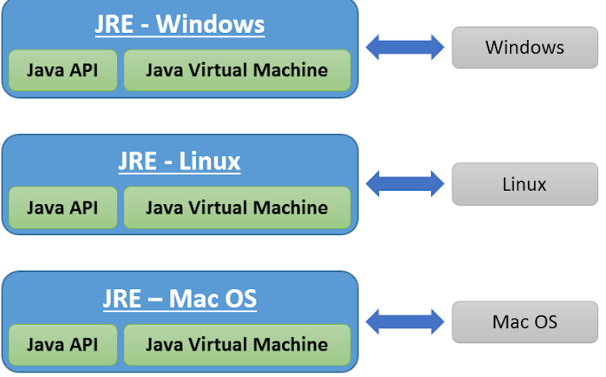
What is JVM?
A Java virtual machine (JVM) is a virtual machine that enables a computer to run Java programs as well as programs written in other languages and compiled to Java bytecode.

Slide 8
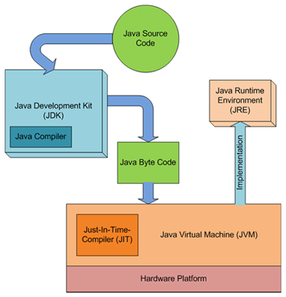
Life Cycle Of JAVA

Slide 9
Java version history
Version | Class File Format | Release Date
JDK Beta | - | 1995
JDK 1.0 | 45 | 1996
JDK 1.1 | 45 | 1997
JDK 1.2 | 46 | 1998
JDK 1.3 | 47 | 2000
JDK 1.4 | 48 | 2002
JDK 5.0 | 49 | 2004
JDK 6.0 | 50 | 2006
JDK 7.0 | 51 | 2011
JDK 8.0(LTS) | 52 | 2014
JDK 9.0 | 53 | 2017
JDK 10.0 | 54 | March 2018
JDK 11.0(LTS) | 55 | September 2018
JDK 12.0 | 56 | March 2019
Version | Class File Format | Release Date
JDK 13.0 | 57 | September 2019
JDK 14.0 | 58 | March 2020
JDK 15.0 | 59 | September 2020
JDK 16.0 | 60 | March 2021
JDK 17.0 (LTS) | 61 | September 2021
JDK 18.0 | 62 | March 2022
JDK 19.0 | 63 | September 2022
JDK 20.0 | 64 | March 2023
JDK 21.0 (LTS) | 65 | September 2023
JDK 22.0 | 66 | March 2024
JDK 23.0 | 67 | September 2024
JDK 24.0 | 68 | March 2025
JDK 25.0 (LTS) | 69 | September 2025

Slide 10
Procedural Programming
Procedural programming (PP), also known as inline programming takes a top-down approach. It is about writing a list of instructions to tell the computer what to do step by step. It relies on procedures or routines.

Slide 11
Object-oriented programming (OOP)
Object-oriented programming (OOP) is a programming paradigm based on the concept of “objects”, which may contain data, in the form of fields, often known as attributes; and code, in the form of procedures, often known as methods.” — Wikipedia

Slide 12
Functional programming (FP)
Functional programming (FP) is about passing data from function to function to get a result.
In FP, functions are treated as data, meaning you can use them as parameters, return them, build functions from other functions, and build custom functions.

Slide 13
What is OOPs?
Object-oriented programming (OOP) is a programming paradigm based on the concept of "objects", which may contain data, in the form of fields, often known as attributes; and code, in the form of procedures, often known as methods.

Slide 14
OOPs Concepts
Object
Class
Inheritance
Polymorphism
Abstraction
Encapsulation
(all data member are private)

